Slide 1

Spring Framework

Slide 2
Spring Framework
Spring framework was first released back in 2003

Slide 3
Spring Framework
Spring framework was first released back in 2003
it enforces programmers to use the best known coding practises

Slide 4
Spring Framework
Spring framework was first released back in 2003
it enforces programmers to use the best known coding practises
key features – inversion of control principle and dependency injection

Slide 5
Spring Framework
Spring framework was first released back in 2003
it enforces programmers to use the best known coding practises
key features – inversion of control principle and dependency injection
the core module in the frameork is the inversion of control container

Slide 6
Spring Framework
Spring framework was first released back in 2003
it enforces programmers to use the best known coding practises
key features – inversion of control principle and dependency injection
the core module in the frameork is the inversion of control container
no need to instantiate the classes – the framework handles everything

Slide 7
Spring Framework
public class Address {
...
}

Slide 8
Spring Framework
public class Address {
...
}
public class Student {
private Address address;
...
}

Slide 9
Spring Framework
we want to have as few dependencies in
our application as possible
IF CLASSES AND MODULES ARE INDEPENDENT THEN WE CAN REUSE THEM WITHOUT
ANY PROBLEM !!!
dependency injection: it glues classes together
but keeps them as independent as possible
public class Address {
...
}
public class Student {
private Address address;
...
}

Slide 10

Spring Framework
we can develop enterprise applications using POJOs (instead
of enterprise beans) so we do not need an EJB container such as
an application server – we can use servlet containeras well

Slide 11
Spring Framework
we can develop enterprise applications using POJOs (instead
of enterprise beans) so we do not need an EJB container such as
an application server – we can use servlet containeras well
Spring framework make use of existing technologies (ORM etc.)

Slide 12
Spring Framework
we can develop enterprise applications using POJOs (instead
of enterprise beans) so we do not need an EJB container such as
an application server – we can use servlet containeras well
Spring framework make use of existing technologies (ORM etc.)
it has a lightweight IoC container compared to EJB containers – so
we can deploy our application on computers with limited resources

Slide 13
Monolithic Architecture

Slide 14

Spring Boot

Slide 15
Spring Boot
Spring boot is an open-source micro framework (Spring module) that provides RAD (Rapid Application Development) feature to the Spring framework

Slide 16
Spring Boot
Spring boot is an open-source micro framework (Spring module) that provides RAD (Rapid Application Development) feature to the Spring framework
it makes it easy to create standalone, production-grade Spring based applications that you can just run

Slide 17
Spring Boot
Spring boot is an open-source micro framework (Spring module) that provides RAD (Rapid Application Development) feature to the Spring framework
it makes it easy to create standalone, production-grade Spring based applications that you can just run
Spring boot applications need minimal Spring configurations

Slide 18
Spring Boot
feature #1 – you can create standalone Spring applications

Slide 19
Spring Boot
feature #1 – you can create standalone Spring applications
feature #2 – embed Tomcat, Jetty or Undertow directly (we can create .jar as well as .war deployment)

Slide 20
Spring Boot
feature #1 – you can create standalone Spring applications
feature #2 – embed Tomcat, Jetty or Undertow directly (we can create .jar as well as .war deployment)
feature #3 – Spring boot provides starter dependencies to simplify your build configurations

Slide 21
Spring Boot
feature #1 – you can create standalone Spring applications
feature #2 – embed Tomcat, Jetty or Undertow directly (we can create .jar as well as .war deployment)
feature #3 – Spring boot provides starter dependencies to simplify your build configurations
feature #4 – automatically configures Spring and 3rd party libraries whenever possible

Slide 22
Spring Boot
feature #1 – you can create standalone Spring applications
feature #2 – embed Tomcat, Jetty or Undertow directly (we can create .jar as well as .war deployment)
feature #3 – Spring boot provides starter dependencies to simplify your build configurations
feature #4 – automatically configures Spring and 3rd party libraries whenever possible
feature #5 – no need for XML based configuration

Slide 23
Spring Boot
U S E R
SPRING FRAMEWORK

Slide 24
Spring Boot
U S E R
SPRING FRAMEWORK
SPRING BOOT

Slide 25
Monolithic Architecture

Slide 26
Monolithic Architecture
APPLICATION
(single .jar or .war file)

Slide 27
Monolithic Architecture
APPLICATION
(single .jar or .war file)
component #1

Slide 28
Monolithic Architecture
APPLICATION
(single .jar or .war file)
component #1
component #2

Slide 29
Monolithic Architecture
APPLICATION
(single .jar or .war file)
component #1
component #2
component #3

Slide 30
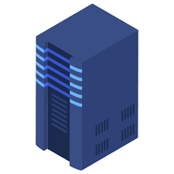
Monolithic Architecture
APPLICATION
(single .jar or .war file)
we build the application into a single .jar or
.war file and then deploy that file
to a given server
component #1
component #2
component #3

Slide 31

Monolithic Architecture
there may be independent components of the application – but
these are handled as a single unit „monolith”

Slide 32
Monolithic Architecture
there may be independent components of the application – but
these are handled as a single unit „monolith”
there may be independent services within the application – but
these are just parts of the large application

Slide 33
Monolithic Architecture
there may be independent components of the application – but
these are handled as a single unit „monolith”
there may be independent services within the application – but
these are just parts of the large application
it is relatively easy to test – so the development is quite fast
(suitable for small applications)

Slide 34
Monolithic Architecture
MONOLITH APPLICATION
(single .jar or .war file)
component #1
component #2
component #3

Slide 35
Monolithic Architecture
it’s easier to develop monolithic applications
and easier to test them
MONOLITH APPLICATION
(single .jar or .war file)
component #1
component #2
component #3

Slide 36

Monolithic Architecture
it’s easier to develop monolithic applications
and easier to test them
MONOLITH APPLICATION
(single .jar or .war file)
the whole application fails if one of it’s components fail
component #1
component #2
component #3

Slide 37
Monolithic Architecture
it’s easier to develop monolithic applications
and easier to test them
MONOLITH APPLICATION
(single .jar or .war file)
the whole application fails if one of it’s components fail
component #1
component #2
you have to recompile the whole project
(build) and have to deploy again
component #3

Slide 38
Monolithic Architecture
it’s easier to develop monolithic applications
and easier to test them
MONOLITH APPLICATION
(single .jar or .war file)
the whole application fails if one of it’s components fail
component #1
component #2
you have to recompile the whole project
(build) and have to deploy again
component #3
scalability issues

Slide 39
Web Services

Slide 40


Web Services
– WEB SERVICE –
a software system to support machine-to-machine
interaction over the internet

Slide 41
Web Services
– WEB SERVICE –
a software system to support machine-to-machine
interaction over the internet
INTEROPERABILITY: applications should be
able to talk to the web service independent
of the programming language they use

Slide 42

Web Services
– WEB SERVICE –
a software system to support machine-to-machine
interaction over the internet
#1 APP (Java)
INTEROPERABILITY: applications should be
able to talk to the web service independent
of the programming language they use

Slide 43

Web Services
– WEB SERVICE –
a software system to support machine-to-machine
interaction over the internet
#1 APP (Java)
#2 APP (C++)
INTEROPERABILITY: applications should be
able to talk to the web service independent
of the programming language they use

Slide 44
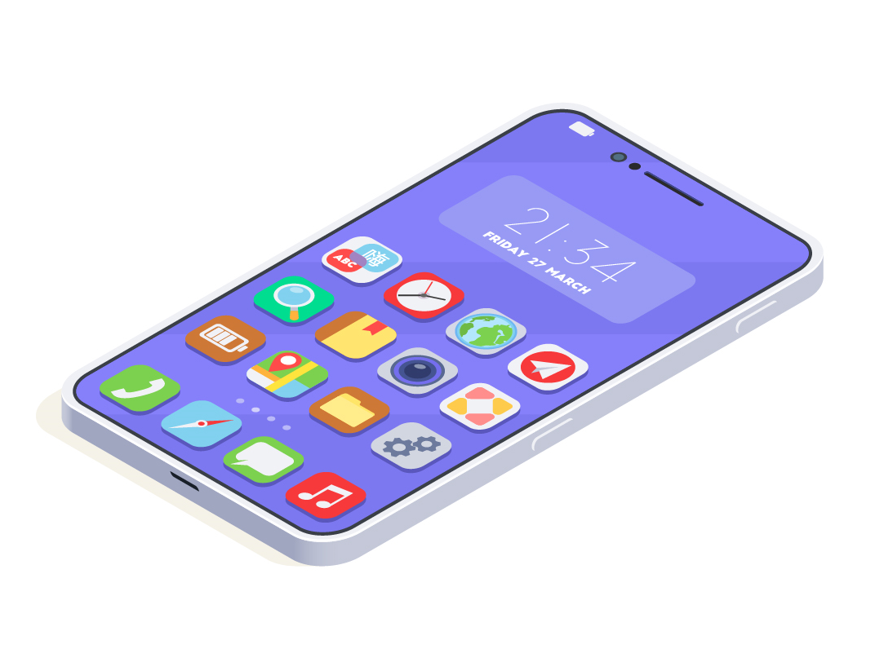
Web Services
– WEB SERVICE –
a software system to support machine-to-machine
interaction over the internet
#1 APP (Java)
#2 APP (C++)
INTEROPERABILITY: applications should be
able to talk to the web service independent
of the programming language they use
#3 APP (Python)

Slide 45
Web Services
web service is a software system to support
machine-to-machine interaction

Slide 46
Web Services
web service is a software system to support
machine-to-machine interaction
technology independent – multiple programming languages are able
to talk to the web service

Slide 47
Web Services
web service is a software system to support
machine-to-machine interaction
technology independent – multiple programming languages are able
to talk to the web service
the apps communicate via the internet – they can be deployed
independetly to different locations

Slide 48
Web Services
SERVICE CONSUMER
SERVICE PROVIDER
#2 APP (C++)

Slide 49
Web Services
SERVICE CONSUMER
SERVICE PROVIDER
REQUEST
#2 APP (C++)
RESPONSE

Slide 50
Web Services
SERVICE CONSUMER
SERVICE PROVIDER
REQUEST
#2 APP (C++)
RESPONSE
we can make the web service platform independent if
the communication (request/response) is platform independent
For example: we can use message queues (WebSphere MQ)
or XML and JSON based communication

Slide 51
Web Services
SERVICE DEFINITION
response/request format
response/request structure
endpoint

Slide 52
Web Services
THERE ARE DIFFERENT WEB SERVICE GROUPS:

Slide 53

Web Services
THERE ARE DIFFERENT WEB SERVICE GROUPS:
SOAP based web services – essentilly it is a protocol

Slide 54
Web Services
THERE ARE DIFFERENT WEB SERVICE GROUPS:
SOAP based web services – essentilly it is a protocol
REST based services – which is an architectura approach (style)

Slide 55
Web Services

Slide 56
SOAP (Simple Object Access Protocol)
SERVICE CONSUMER
SERVICE PROVIDER
XML REQUEST
#2 APP (C++)
XML RESPONSE

Slide 57
SOAP (Simple Object Access Protocol)
SERVICE CONSUMER
SERVICE PROVIDER
XML REQUEST
#2 APP (C++)
XML RESPONSE
SOAP is a messaging protocol specification for exchanging
structured information in XML format
THE COMMUNICATION IS WELL-DEFINED !!!
(this is why it is a protocol)

Slide 58
SOAP (Simple Object Access Protocol)
SERVICE CONSUMER
SERVICE PROVIDER
XML REQUEST
#2 APP (C++)
XML RESPONSE
implementation often uses HTTP as a transport protocol but other
protocols can be used such as SMTP, message queues etc.

Slide 59
SOAP (Simple Object Access Protocol)
SOAP ENVELOPE
SOAP Header
SOAP Body

Slide 60
SOAP (Simple Object Access Protocol)
SOAP ENVELOPE
the SOAP header contains application specific
information: the authentication, authorization
and encryption related data
SOAP Header
SOAP Body

Slide 61
SOAP (Simple Object Access Protocol)
SOAP ENVELOPE
SOAP Header
SOAP Body
the SOAP body contains the
request and response accordingly

Slide 62
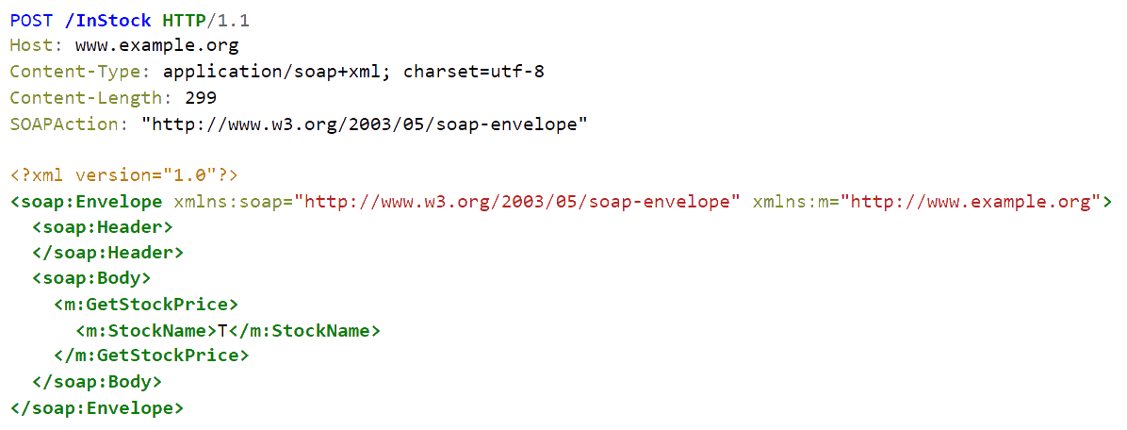
SOAP (Simple Object Access Protocol)

Slide 63
Web Services

Slide 64
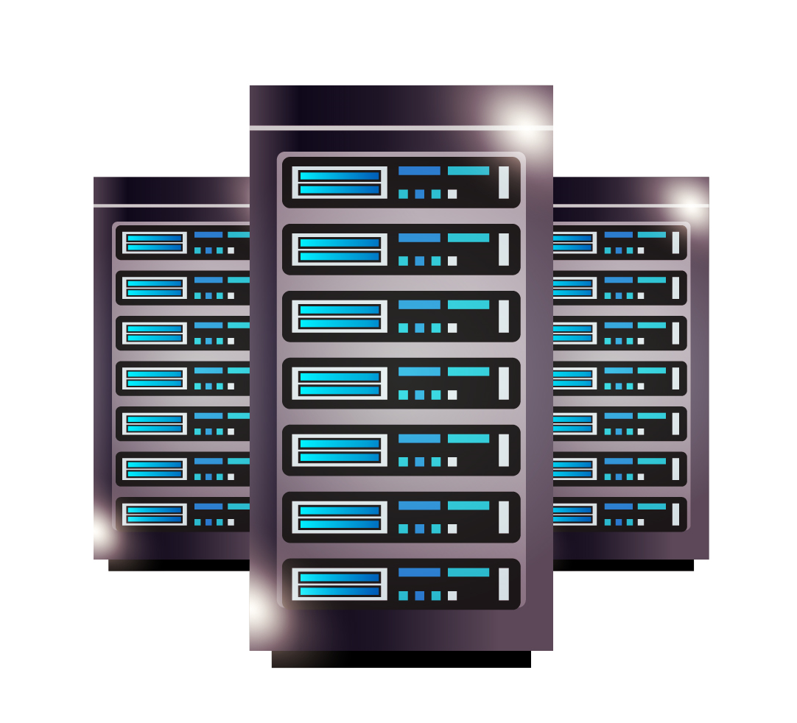
HTTP (Hypertext Transfer Protocol)
if the client visits a website then the data
will be fetched from the server with
REQUEST
RESPONSE
Hypertext Transfer Protocol (HTTP) is used for
viewing web pages. It is a request-response protocol
in the client-server computing model
every single website is stored on a so-called server
(images, texts and all the data)

Slide 65
How to Make a Server Scalable?

Slide 66
How to Make a Server Scalable?
we can make a server (application) scalable if it is stateless (no information is stored about the client)

Slide 67
How to Make a Server Scalable?
we can make a server (application) scalable if it is stateless (no information is stored about the client)
the client’s request contains all the information needed for the given request

Slide 68
How to Make a Server Scalable?
we can make a server (application) scalable if it is stateless (no information is stored about the client)
the client’s request contains all the information needed for the given request
server can handle multiple requests as it does not have to store information

Slide 69
HTTP (Hypertext Transfer Protocol)

Slide 70
HTTP (Hypertext Transfer Protocol)
HTTP allows applications to communicate

Slide 71
HTTP (Hypertext Transfer Protocol)
HTTP allows applications to communicate
it is a TCP/IP based protocol

Slide 72
HTTP (Hypertext Transfer Protocol)
HTTP allows applications to communicate
it is a TCP/IP based protocol
stateless – every request is independent and does not relate to previous requests

Slide 73
HTTP (Hypertext Transfer Protocol)
HTTP allows applications to communicate
it is a TCP/IP based protocol
stateless – every request is independent and does not relate to previous requests
connectionless – the client disconnects from the server after the request and vice versa

Slide 74
HTTP (Hypertext Transfer Protocol)
HTTP REQUEST
START LINE
HEADER
BODY

Slide 75
HTTP (Hypertext Transfer Protocol)
the HTTP start line contains several
parameters of the request
method: GET, POST, PUT, DELETE
resource location (URI)
version: HTTP/1.0
HTTP REQUEST
START LINE
HEADER
BODY

Slide 76
HTTP (Hypertext Transfer Protocol)
the HTTP header contains several
parameters of the host
host: http://aws-test/users
accept (MIME): text/html or image/png
cookie: session ID etc.
HTTP REQUEST
START LINE
HEADER
BODY

Slide 77
HTTP (Hypertext Transfer Protocol)
HTTP REQUEST
START LINE
the HTTP body may or may not contain
several parameters (JSON or XML)
HEADER
BODY
{
"name":"John",
"age":30
}

Slide 78
HTTP (Hypertext Transfer Protocol)
HTTP RESPONSE
START LINE
HEADER
BODY

Slide 79
HTTP (Hypertext Transfer Protocol)
the HTTP start line contains several
return values of the response
version: HTTP/1.0
status code: 200 (OK) 404 (Not Found)
500 (Server Error)
HTTP RESPONSE
START LINE
HEADER
BODY

Slide 80
HTTP (Hypertext Transfer Protocol)
HTTP RESPONSE
the HTTP header contains several
information related to the result
content type: text/html or image/png
content-length (in bytes)
START LINE
HEADER
BODY

Slide 81
HTTP (Hypertext Transfer Protocol)
HTTP RESPONSE
START LINE
HEADER
BODY
the HTTP body is important because
It contains the response of the server
(for example the HTML content of a website)

Slide 82
HTTP (Hypertext Transfer Protocol)
GET it is used to get (or read) data from a web server and
the server returns with status code 200 if everything went well

Slide 83
HTTP (Hypertext Transfer Protocol)
GET it is used to get (or read) data from a web server and
the server returns with status code 200 if everything went well
POST it is used to send data (files, images etc.) to a web server and
the server returns with status code 201 if everything went well

Slide 84
HTTP (Hypertext Transfer Protocol)
GET it is used to get (or read) data from a web server and
the server returns with status code 200 if everything went well
POST it is used to send data (files, images etc.) to a web server and
the server returns with status code 201 if everything went well
PUT it is used to modify data that is already present on a web server or
the server creates entry if the data is not present

Slide 85
HTTP (Hypertext Transfer Protocol)
GET it is used to get (or read) data from a web server and
the server returns with status code 200 if everything went well
POST it is used to send data (files, images etc.) to a web server and
the server returns with status code 201 if everything went well
PUT it is used to modify data that is already present on a web server or
the server creates entry if the data is not present
DELETE it is used to delete a given resource on a web server

Slide 86
Web Services

Slide 87
REST (Representational State Transfer)
SERVICE CONSUMER
SERVICE PROVIDER
REQUEST
APP (Java)
RESPONSE
Roy Fielding introduced and defined REST back in 2000
(he is a huge fan of HTTP – this is why HTTP is the transport protocol )

Slide 88
REST (Representational State Transfer)
REST services are HTTP based architectural approaches

Slide 89
REST (Representational State Transfer)
REST services are HTTP based architectural approaches
resource: key abstraction in REST services, essentially everything we want to access with request (and has a URI)

Slide 90
REST (Representational State Transfer)
REST services are HTTP based architectural approaches
resource: key abstraction in REST services, essentially everything we want to access with request (and has a URI)
representation: this is what the REST service returns in the response

Slide 91
REST (Representational State Transfer)
REST services are HTTP based architectural approaches
resource: key abstraction in REST services, essentially everything we want to access with request (and has a URI)
representation: this is what the REST service returns in the response
there may be several representation formats available (XML, JSON etc.)

Slide 92
REST (Representational State Transfer)
REST services are HTTP based architectural approaches
resource: key abstraction in REST services, essentially everything we want to access with request (and has a URI)
representation: this is what the REST service returns in the response
there may be several representation formats available (XML, JSON etc.)
there is no service definiton (as we have seen with SOAP)

Slide 93





REST (Representational State Transfer)
#2
REST SERVICE
#1
REST SERVICE
#3
REST SERVICE

Slide 94
REST (Representational State Transfer)
#2
REST SERVICE
#1
REST SERVICE
HTTP/JSON
HTTP/JSON
HTTP/JSON
#3
REST SERVICE

Slide 95
Web Services

Slide 96
Microservice Architecture
MONOLITH APPLICATION
(single .jar or .war file)
shipping
inventory
login

Slide 97
Microservice Architecture
SHIPPING SERVICE
(single .jar or .war file)
MONOLITH APPLICATION
(single .jar or .war file)
DB
shipping
inventory
login

Slide 98
Microservice Architecture
SHIPPING SERVICE
(single .jar or .war file)
MONOLITH APPLICATION
(single .jar or .war file)
DB
shipping
INVENTORY SERVICE
(single .jar or .war file)
inventory
DB
login

Slide 99
Microservice Architecture
SHIPPING SERVICE
(single .jar or .war file)
MONOLITH APPLICATION
(single .jar or .war file)
DB
shipping
INVENTORY SERVICE
(single .jar or .war file)
inventory
DB
login
LOGIN SERVICE
(single .jar or .war file)
DB

Slide 100
Microservice Architecture
SHIPPING SERVICE
(single .jar or .war file)
MONOLITH APPLICATION
(single .jar or .war file)
DB
shipping
INVENTORY SERVICE
(single .jar or .war file)
inventory
DB
login
LOGIN SERVICE
(single .jar or .war file)
DB

Slide 101
Microservice Architecture
it’s harder to develop microservice applications
and harder to test them

Slide 102
Microservice Architecture
it’s harder to develop microservice applications
and harder to test them
one service may fail and other parts of the application can work fine

Slide 103
Microservice Architecture
it’s harder to develop microservice applications
and harder to test them
one service may fail and other parts of the application can work fine
we can deploy just the service (not the whole application itself) + services can be implemented in different programming languages

Slide 104
Microservice Architecture
it’s harder to develop microservice applications
and harder to test them
one service may fail and other parts of the application can work fine
we can deploy just the service (not the whole application itself) + services can be implemented in different programming languages
we can scale the services independently (decoupled software architecture)

Slide 105
Microservice Architecture
it’s harder to develop microservice applications
and harder to test them
one service may fail and other parts of the application can work fine
we can deploy just the service (not the whole application itself) + services can be implemented in different programming languages
we can scale the services independently (decoupled software architecture)

Slide 106
Microservice Architecture
#2
MICROSERVICE
#1
MICROSERVICE
#3
MICROSERVICE

Slide 107
Microservice Architecture
#2
MICROSERVICE
#1
MICROSERVICE
HTTP
HTTP
HTTP
#3
MICROSERVICE

Slide 108
Microservice Architecture

Slide 109
Microservices
#1
MICROSERVICE
(user-service)

Slide 110
Microservices
#1
MICROSERVICE
(user-service)
#2
MICROSERVICE
(car-rental service)

Slide 111
Microservices
#1
MICROSERVICE
(user-service)
HTTP
#2
MICROSERVICE
(car-rental service)
HTTP

Slide 112
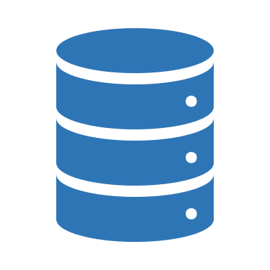
Microservices
M I C R O S E R V I C E
C
O
N
T
R
O
L
L
E
R
R E P O S I T O R Y
REQUEST
SERVICE
RESPONSE

Slide 113
Microservices

Slide 114
JSON
we have the JSON representation of a
given user that we want to store
in the database
{
"name":"John Smith",
"age":30
“children":[„Ana”, „Adam”]
}

Slide 115
JSON
public class User {
private String name;
private int age;
private List<String> children;
...
}
we have the JSON representation of a
given user that we want to store
in the database
{
"name":"John Smith",
"age":30
“children":[„Ana”, „Adam”]
}
we have the object-oriented
representation of the data
(with the User class)

Slide 116

JSON
JSON (JavaScript Object Notation) was first used back in 2001

Slide 117
JSON
JSON (JavaScript Object Notation) was first used back in 2001
it is an open standard file format and data interchange format that uses human-readable text to store and trasmit attribute-value pairs

Slide 118
JSON
JSON (JavaScript Object Notation) was first used back in 2001
it is an open standard file format and data interchange format that uses human-readable text to store and trasmit attribute-value pairs
it is derived from JavaScript and use the .json extension

Slide 119
Microservices

Slide 120
Databases
our Java
desktop or web
application

Slide 121
Databases
Database Management System (DBMS)
our Java
desktop or web
application

Slide 122
Databases
Java Database Connectivity
(JDBC)
+ driver
Database Management System (DBMS)
our Java
desktop or web
application

Slide 123

Databases
JDBC (Java Database Connectivity) is a technology to interact with an underlying database

Slide 124
Databases
JDBC (Java Database Connectivity) is a technology to interact with an underlying database
JDBC is essentially an API (a specification) for connecting Java apps to databases

Slide 125
Databases
JDBC (Java Database Connectivity) is a technology to interact with an underlying database
JDBC is essentially an API (a specification) for connecting Java apps to databases
each JDBC driver allows communication with different databses (MySQL, Oracle etc.)

Slide 126
Databases

Slide 127

Java Persistence API (JPA)
the first specification was released back in 2006

Slide 128
Java Persistence API (JPA)
the first specification was released back in 2006
developers need a lot of work to configure and connect to databases (with JDBC)

Slide 129
Java Persistence API (JPA)
the first specification was released back in 2006
developers need a lot of work to configure and connect to databases (with JDBC)
JPA reduces the database related interactions significantly (it maps Java objects to relational models)

Slide 130
Java Persistence API (JPA)
the first specification was released back in 2006
developers need a lot of work to configure and connect to databases (with JDBC)
JPA reduces the database related interactions significantly (it maps Java objects to relational models)
we can focus on business logic – and we can deal with Java classes exclusively

Slide 131
Java Persistence API (JPA)
Java Database Connectivity
(JDBC)
+ driver
Database Management System (DBMS)
our Java
desktop or web
application

Slide 132
Java Persistence API (JPA)
Java Persistance API
(JPA)
our Java
desktop or web
application

Slide 133
Java Persistence API (JPA)
public class Student {
private String name;
private int age;
...
}

Slide 134
Java Persistence API (JPA)
public class Student {
private String name;
private int age;
...
}
Student s1 = new Student(„Adam”, 31);
Student s2 = new Student(„Ana”, 25);
Student s3 = new Student(„Daniel”, 19);

Slide 135
Java Persistence API (JPA)
public class Student {
private String name;
private int age;
...
}
name | age
Adam | 31
Ana | 25
Daniel | 19
Student s1 = new Student(„Adam”, 31);
Student s2 = new Student(„Ana”, 25);
Student s3 = new Student(„Daniel”, 19);

Slide 136
Java Persistence API (JPA)
JPA is not a tool or framework rather it defines a set of concepts (specification) that can be implemented by any tool or framework.

Slide 137

Java Persistence API (JPA)
JPA is not a tool or framework rather it defines a set of concepts (specification) that can be implemented by any tool or framework.

Slide 138

Java Persistence API (JPA)
JPA is not a tool or framework rather it defines a set of concepts (specification) that can be implemented by any tool or framework.

Slide 139

Java Persistence API (JPA)
JPA is not a tool or framework rather it defines a set of concepts (specification) that can be implemented by any tool or framework.

Slide 140
Java Persistence API (JPA)

Slide 141
Object-Relational Mapping (ORM)
public class Student {
private String name;
private int age;
...
}
name | age
Adam | 31
Ana | 25
Daniel | 19
Student s1 = new Student(„Adam”, 31);
Student s2 = new Student(„Ana”, 25);
Student s3 = new Student(„Daniel”, 19);

Slide 142
Object-Relational Mapping (ORM)
this is the object relational mapping: we have an orm.xml file that contains all the information – or we can configure it via annotations

Slide 143
Object-Relational Mapping (ORM)
this is the object relational mapping: we have an orm.xml file that contains all the information – or we can configure it via annotations
object-relational mapping (ORM) is a functionality which is used to develop and maintain a relationship between an object and relational database by mapping an object state to database column.

Slide 144
Object-Relational Mapping (ORM)
this is the object relational mapping: we have an orm.xml file that contains all the information – or we can configure it via annotations
object-relational mapping (ORM) is a functionality which is used to develop and maintain a relationship between an object and relational database by mapping an object state to database column.
XML configuration is faster because it does not require compilation

Slide 145
Object-Relational Mapping (ORM)
this is the object relational mapping: we have an orm.xml file that contains all the information – or we can configure it via annotations
object-relational mapping (ORM) is a functionality which is used to develop and maintain a relationship between an object and relational database by mapping an object state to database column.
XML configuration is faster because it does not require compilation
annotations uses reflection under the hood which is slower

Slide 146
Java Persistence API (JPA)

Slide 147

Transactions
transaction means a sequence of information exchange and related work that is treated as a single unit of work

Slide 148
Transactions
transaction means a sequence of information exchange and related work that is treated as a single unit of work
IT ENSURES DATABASE INTEGRITY !!!
a transaction has to be entirely complete otherwise there will be a rollback

Slide 149
Transactions
transaction means a sequence of information exchange and related work that is treated as a single unit of work
IT ENSURES DATABASE INTEGRITY !!!
a transaction has to be entirely complete otherwise there will be a rollback

Slide 150
Transactions
public method saveStudent() {
Person person = loadPerson(personId);
Address address = loadAddress(person);
updatePersonAddress(address);
savePerson(person);
}

Slide 151
Transactions
public method saveStudent() {
Person person = loadPerson(personId);
Address address = loadAddress(person);
updatePersonAddress(address);
savePerson(person);
}

Slide 152
Transactions
public method saveStudent() {
Person person = loadPerson(personId);
Address address = loadAddress(person);
updatePersonAddress(address);
savePerson(person);
}

Slide 153
Transactions
@Transactional
public method saveStudent() {
Person person = loadPerson(personId);
Address address = loadAddress(person);
updatePersonAddress(address);
savePerson(person);
}

Slide 154
Transactions
@Transactional
public method saveStudent() {
Person person = loadPerson(personId);
Address address = loadAddress(person);
updatePersonAddress(address);
savePerson(person);
}

Slide 155
Transactions
@Transactional
public method saveStudent() {
Person person = loadPerson(personId);
Address address = loadAddress(person);
updatePersonAddress(address);
savePerson(person);
}

Slide 156
Transactions
@Transactional
public method saveStudent() {
Person person = loadPerson(personId);
Address address = loadAddress(person);
updatePersonAddress(address);
savePerson(person);
}
ROLLBACK !!!

Slide 157
Transactions
@Transactional
public method saveStudent() {
Person person = loadPerson(personId);
Address address = loadAddress(person);
updatePersonAddress(address);
savePerson(person);
}

Slide 158
Transactions
Connection connection = dataSource.getConnection();
try {
connection.setAutoCommit(false);
connection.commit();
} catch(SQLException e) {
connection.rollback();
}

Slide 159
Transactions
Connection connection = dataSource.getConnection();
try {
connection.setAutoCommit(false);
updatePersonAddress(address);
savePerson(person);
connection.commit();
} catch(SQLException e) {
connection.rollback();
}

Slide 160
Transactions
class UserController {
@Autowired
UserService userService;
}
class UserService {
service.save();
}

Slide 161
Transactions
class UserController {
@Autowired
UserService userService;
}
class UserServiceProxy {
openTransaction();
closeTransaction();
}
class UserService {
service.save();
}

Slide 162
API Gateway
SHIPPING SERVICE
(single .jar or .war file)
MONOLITH APPLICATION
(single .jar or .war file)
DB
shipping
INVENTORY SERVICE
(single .jar or .war file)
inventory
DB
login
LOGIN SERVICE
(single .jar or .war file)
DB

Slide 163
API Gateway
SHIPPING SERVICE
(single .jar or .war file)
DB
INVENTORY SERVICE
(single .jar or .war file)
DB
THE CLIENT
(that is the service consumer)
LOGIN SERVICE
(single .jar or .war file)
DB

Slide 164
API Gateway
API GATEWAY
SHIPPING SERVICE
(single .jar or .war file)
DB
INVENTORY SERVICE
(single .jar or .war file)
DB
THE CLIENT
(that is the service consumer)
LOGIN SERVICE
(single .jar or .war file)
DB

Slide 165


API Gateway

Slide 166
API Gateway

Slide 167

Sessions and Cookies
we can make client-server architecture scalable if the server knows nothing about the client – no need to store any data

Slide 168
Sessions and Cookies
we can make client-server architecture scalable if the server knows nothing about the client – no need to store any data
HTTP IS A STATELESS PROTOCOL !!!

Slide 169
Sessions and Cookies
we can make client-server architecture scalable if the server knows nothing about the client – no need to store any data
HTTP IS A STATELESS PROTOCOL !!!
but how to store the users after authentication?

Slide 170
Sessions and Cookies
we can make client-server architecture scalable if the server knows nothing about the client – no need to store any data
HTTP IS A STATELESS PROTOCOL !!!
but how to store the users after authentication?
this is exactly why sessions, cookies and JWT came to be to handle authentication easily and to remeber the state of the application

Slide 171
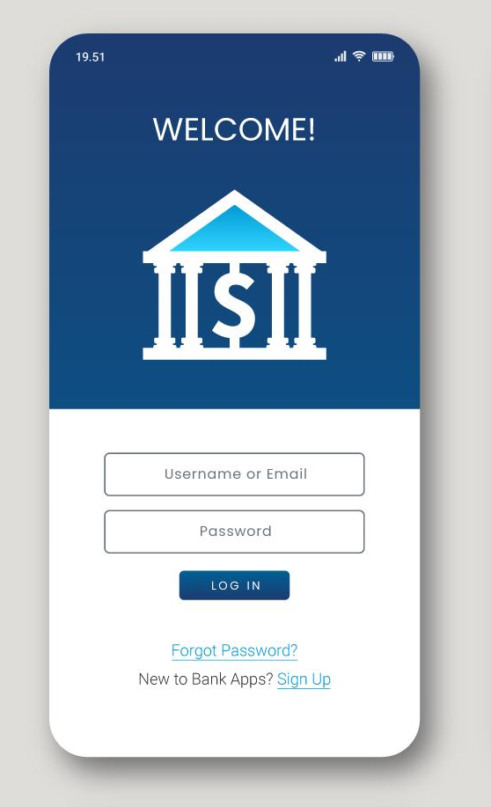
Sessions and Cookies

Slide 172
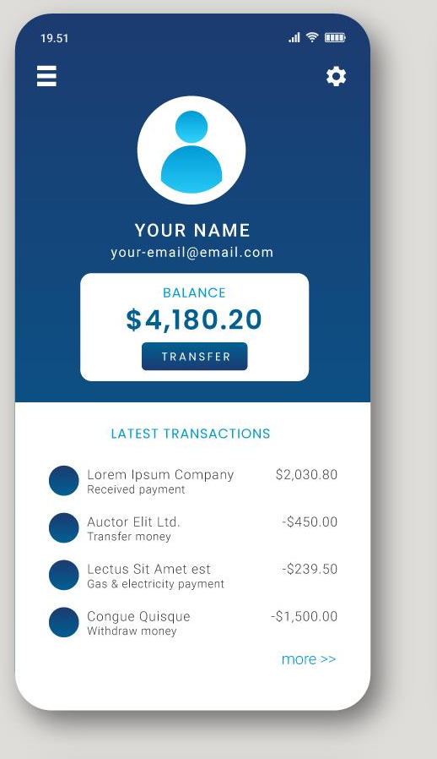
Sessions and Cookies

Slide 173
Sessions and Cookies

Slide 174
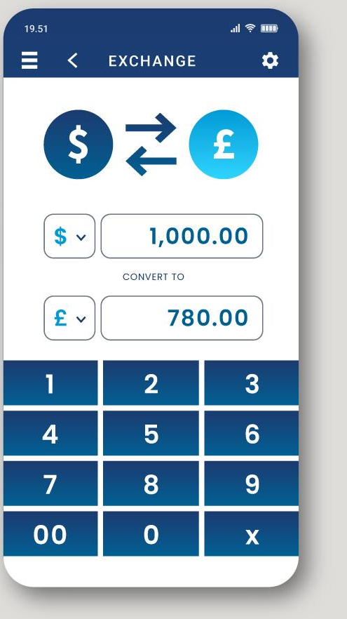
Sessions and Cookies

Slide 175
Sessions and Cookies

Slide 176
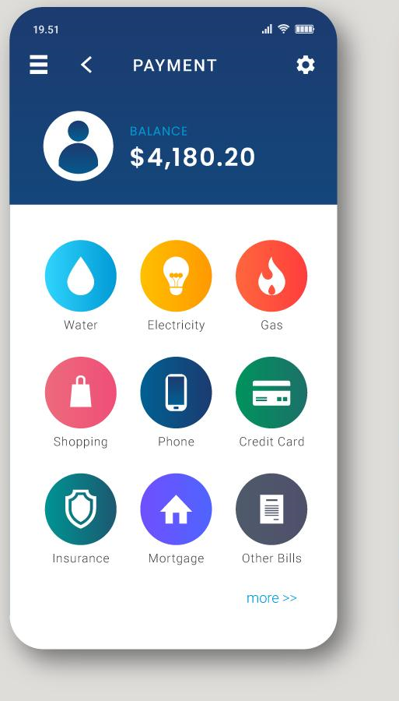
Sessions and Cookies

Slide 177
Sessions and Cookies

Slide 178
Sessions and Cookies

Slide 179
Sessions and Cookies

Slide 180
Sessions and Cookies

Slide 181
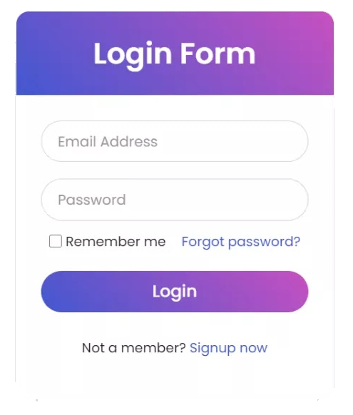
Sessions and Cookies
when we login to an application then a new session is created in an underlying database table
SESSION_ID IS SENT BACK TO THE CLIENT
AND STORED AS A COOKIE !!!
user_id | session_id | login_time | IP_address
1 | 32142 | 2022-01-20 | 98.66.69.60.
2 | 84748 | 2022-06-05 | 21.33.02.00.
3 | 37627 | 2023-01-20 | 13.28.56.74.
4 | 98382 | 2022-12-11 | 99.32.55.67.

Slide 182
Sessions and Cookies
when the session expires (which means that the cookie expires as well) then the session table removes the given row
THE USER HAS TO AUTHENTICATE
HIMSELF AGAIN !!!
user_id | session_id | login_time | IP_address
1 | 32142 | 2022-01-20 | 98.66.69.60.
2 | 84748 | 2022-06-05 | 21.33.02.00.
3 | 37627 | 2023-01-20 | 13.28.56.74.
4 | 98382 | 2022-12-11 | 99.32.55.67.

Slide 183
Sessions and Cookies
when the session expires (which means that the cookie expires as well) then the session table removes the given row
THE USER HAS TO AUTHENTICATE
HIMSELF AGAIN !!!
user_id | session_id | login_time | IP_address
1 | 32142 | 2022-01-20 | 98.66.69.60.
3 | 37627 | 2023-01-20 | 13.28.56.74.
4 | 98382 | 2022-12-11 | 99.32.55.67.

Slide 184
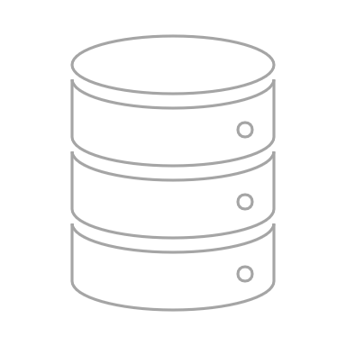
Sessions and Cookies
when the session expires (which means that the cookie expires as well) then the session table removes the given row
THE USER HAS TO AUTHENTICATE
HIMSELF AGAIN !!!
THIS IS WHY THIS SESSION BASED APPROACH IS NOT SCALABLE !!!
we have to make a huge number of database related operations to check whether the session is still alive etc.
user_id | session_id | login_time | IP_address
1 | 32142 | 2022-01-20 | 98.66.69.60.
3 | 37627 | 2023-01-20 | 13.28.56.74.
4 | 98382 | 2022-12-11 | 99.32.55.67.

Slide 185
API Gateway

Slide 186

JSON Web Tokens (JWT)
JSON Web Tokens (JWT) is an open standard that defines a self-contained way of transmitting information between parties as JSON object

Slide 187
JSON Web Tokens (JWT)
JSON Web Tokens (JWT) is an open standard that defines a self-contained way of transmitting information between parties as JSON object
IT RELIES HEAVILY ON PUBLIC KEY CRYPTOSYSTEM !!!

Slide 188
JSON Web Tokens (JWT)
JSON Web Tokens (JWT) is an open standard that defines a self-contained way of transmitting information between parties as JSON object
IT RELIES HEAVILY ON PUBLIC KEY CRYPTOSYSTEM !!!
information can be trusted and verified because it is digtially signed - it uses RSA and ECDSA as algorithms

Slide 189
JSON Web Tokens (JWT)
JSON Web Tokens (JWT) is an open standard that defines a self-contained way of transmitting information between parties as JSON object
IT RELIES HEAVILY ON PUBLIC KEY CRYPTOSYSTEM !!!
information can be trusted and verified because it is digtially signed - it uses RSA and ECDSA as algorithms
tokens can verify the integrity of the data and the signature certifies that only the party holding the private key is the one that signed it

Slide 190
JSON Web Tokens (JWT)
JSON Web Token
(JWT)
header
payload
signature

Slide 191
JSON Web Tokens (JWT)
it contains the type of the token
and the signing algorithm in Base64 encoded
format (first par of the token)
JSON Web Token
(JWT)
{
”alg":”HS256",
”typ":”JWT”
}
header
payload
signature

Slide 192
JSON Web Tokens (JWT)
JSON Web Token
(JWT)
it contains a huge number of information
about the token – such as the issuer and the
the expiration time in Base64 encoded format
header
payload
{
”name":”John Smith",
”role":”admin”,
”exp":”2023-01-11 11:00:00”
}
signature

Slide 193
JSON Web Tokens (JWT)
JSON Web Token
(JWT)
header
it takes the header and the payload
(and a secret value) and generates the signature
if something is changed then the
signature will not be valid
+ the signature verifies the
sender (authorization)
payload
signature

Slide 194
JSON Web Tokens (JWT)

Slide 195
Docker and Virtualization
DEVELOPMENT ENVIRONMENT

Slide 196


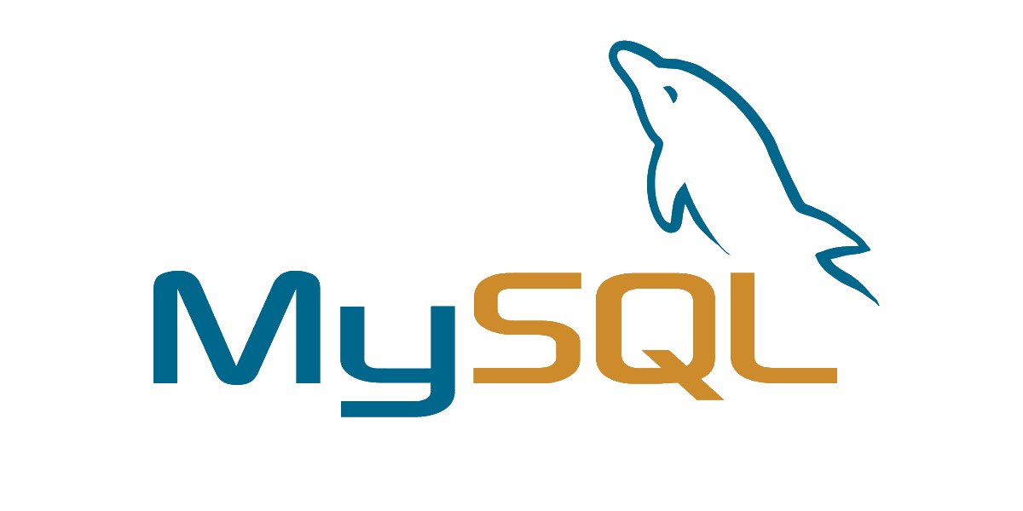
Docker and Virtualization
DEVELOPMENT ENVIRONMENT
Windows 10
Java 8
MySQL 5.8

Slide 197
Docker and Virtualization
DEVELOPMENT ENVIRONMENT
TEST ENVIRONMENT
Windows 10
Java 8
MySQL 5.8

Slide 198

Docker and Virtualization
DEVELOPMENT ENVIRONMENT
TEST ENVIRONMENT
Windows 10
Linux
Java 8
Java 17
MySQL 5.8
MySQL 8.0

Slide 199

Docker and Virtualization
a given application is developed on a given operation system (usually Windows)

Slide 200
Docker and Virtualization
a given application is developed on a given operation system (usually Windows)
other developers or test engineers may use other operation systems (other versions etc.)

Slide 201
Docker and Virtualization
a given application is developed on a given operation system (usually Windows)
other developers or test engineers may use other operation systems (other versions etc.)
THERE MAY BE DIFFERENCES IN THE ENVIRONMENTS !!!

Slide 202
Docker and Virtualization
a given application is developed on a given operation system (usually Windows)
other developers or test engineers may use other operation systems (other versions etc.)
THERE MAY BE DIFFERENCES IN THE ENVIRONMENTS !!!
how to solve this problem? we can use virual machines without any probem

Slide 203
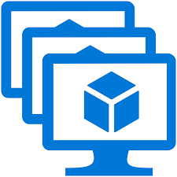
Docker and Virtualization
when using virtualization and virtual
machines – there are always the virtual operation
systems (guest OS) that are on the top of the
standard system (host OS)

Slide 204
Docker and Virtualization
INFRASTRUCTURE (HARDWARE)

Slide 205
Docker and Virtualization
HOST OS
INFRASTRUCTURE (HARDWARE)

Slide 206
Docker and Virtualization
HYPERVISOR
HOST OS
INFRASTRUCTURE (HARDWARE)

Slide 207
Docker and Virtualization
VM #1
App #1
Bins / Libs
Guest OS
HYPERVISOR
HOST OS
INFRASTRUCTURE (HARDWARE)

Slide 208
Docker and Virtualization
VM #1
VM #2
App #1
App #2
Bins / Libs
Bins / Libs
Guest OS
Guest OS
HYPERVISOR
HOST OS
INFRASTRUCTURE (HARDWARE)

Slide 209
Docker and Virtualization
VM #1
VM #2
VM #3
App #1
App #2
App #3
Bins / Libs
Bins / Libs
Bins / Libs
Guest OS
Guest OS
Guest OS
HYPERVISOR
HOST OS
INFRASTRUCTURE (HARDWARE)

Slide 210
Docker and Virtualization
VM #1
VM #2
VM #3
virtual machines need a lot of memory for the host OS
App #1
App #2
App #3
Bins / Libs
Bins / Libs
Bins / Libs
Guest OS
Guest OS
Guest OS
HYPERVISOR
HOST OS
INFRASTRUCTURE (HARDWARE)

Slide 211
Docker and Virtualization
VM #1
VM #2
VM #3
virtual machines need a lot of memory for the host OS
App #1
App #2
App #3
long boot time
Bins / Libs
Bins / Libs
Bins / Libs
Guest OS
Guest OS
Guest OS
HYPERVISOR
HOST OS
INFRASTRUCTURE (HARDWARE)

Slide 212
Docker and Virtualization
VM #1
VM #2
VM #3
virtual machines need a lot of memory for the host OS
App #1
App #2
App #3
long boot time
Bins / Libs
Bins / Libs
Bins / Libs
Guest OS
Guest OS
Guest OS
hard to scale up
HYPERVISOR
HOST OS
INFRASTRUCTURE (HARDWARE)

Slide 213
Docker and Virtualization
VM #1
VM #2
VM #3
virtual machines need a lot of memory for the host OS
App #1
App #2
App #3
long boot time
Bins / Libs
Bins / Libs
Bins / Libs
Guest OS
Guest OS
Guest OS
hard to scale up
running multiple virtual machines (VMs) leads to unstable performance
HYPERVISOR
HOST OS
INFRASTRUCTURE (HARDWARE)

Slide 214
Docker and Virtualization
VM #1
VM #2
VM #3
virtual machines need a lot of memory for the host OS
App #1
App #2
App #3
long boot time
Bins / Libs
Bins / Libs
Bins / Libs
Guest OS
Guest OS
Guest OS
hard to scale up
running multiple virtual machines (VMs) leads to unstable performance
HYPERVISOR
HOST OS
every application on the server needs an independent VM
INFRASTRUCTURE (HARDWARE)

Slide 215
Docker and Virtualization
VM #1
VM #2
VM #3
virtual machines need a lot of memory for the host OS
App #1
App #2
App #3
long boot time
Bins / Libs
Bins / Libs
Bins / Libs
Guest OS
Guest OS
Guest OS
hard to scale up
running multiple virtual machines (VMs) leads to unstable performance
HYPERVISOR
HOST OS
every application on the server needs an independent VM
INFRASTRUCTURE (HARDWARE)
data can not be shared between the applications (and VMs)

Slide 216
Docker and Virtualization
INFRASTRUCTURE (HARDWARE)

Slide 217
Docker and Virtualization
HOST OS
INFRASTRUCTURE (HARDWARE)

Slide 218
Docker and Virtualization
DOCKER ENGINE
HOST OS
INFRASTRUCTURE (HARDWARE)

Slide 219
Docker and Virtualization
container #1
App #1
Bins / Libs
DOCKER ENGINE
HOST OS
INFRASTRUCTURE (HARDWARE)

Slide 220
Docker and Virtualization
container #1
container #2
App #1
App #2
Bins / Libs
Bins / Libs
DOCKER ENGINE
HOST OS
INFRASTRUCTURE (HARDWARE)

Slide 221
Docker and Virtualization
container #1
container #2
container #3
App #1
App #2
App #3
Bins / Libs
Bins / Libs
Bins / Libs
DOCKER ENGINE
HOST OS
INFRASTRUCTURE (HARDWARE)

Slide 222
Docker and Virtualization
container #1
container #2
container #3
there is no need for virtual machines (VMs) at all
App #1
App #2
App #3
Bins / Libs
Bins / Libs
Bins / Libs
DOCKER ENGINE
HOST OS
INFRASTRUCTURE (HARDWARE)

Slide 223
Docker and Virtualization
container #1
container #2
container #3
there is no need for virtual machines (VMs) at all
App #1
App #2
App #3
Bins / Libs
Bins / Libs
Bins / Libs
fast boot time and less memory
DOCKER ENGINE
HOST OS
INFRASTRUCTURE (HARDWARE)

Slide 224
Docker and Virtualization
container #1
container #2
container #3
there is no need for virtual machines (VMs) at all
App #1
App #2
App #3
Bins / Libs
Bins / Libs
Bins / Libs
fast boot time and less memory
DOCKER ENGINE
easy to scale up
HOST OS
data can be shared among multiple containers and applications
INFRASTRUCTURE (HARDWARE)
DOCKER IS LIGHTWEIGHT VIRTUALIZATION

Slide 225
Docker and Virtualization
container #1
container #2
container #3
there is no need for virtual machines (VMs) at all
App #1
App #2
App #3
Bins / Libs
Bins / Libs
Bins / Libs
fast boot time and less memory
DOCKER ENGINE
easy to scale up
HOST OS
data can be shared among multiple containers and applications
INFRASTRUCTURE (HARDWARE)

Slide 226
Docker and Virtualization
container #1
container #2
container #3
there is no need for virtual machines (VMs) at all
App #1
App #2
App #3
Bins / Libs
Bins / Libs
Bins / Libs
fast boot time and less memory
DOCKER ENGINE
easy to scale up
HOST OS
data can be shared among multiple containers and applications
INFRASTRUCTURE (HARDWARE)
DOCKER IS LIGHTWEIGHT VIRTUALIZATION

Slide 227
Docker and Virtualization
a container is a software package that consists
of all the dependencies required to run an application
it includes source code, JDK and
all the dpenedencies
multiple containers can run on the same hardware and
containers maintains isolated apps
THE SAME CONTAINER ALWAYS YIELD THE EXACT
SAME EXECUTION BEHAVIOR
we can build, test and run in the exact same environment
container
code
dependencies

Slide 228
Docker and Virtualization
container
image
code
dependencies
we package the containers into a so-called
images that can be shared with anyone
(usually we store these images in public registries)

Slide 229
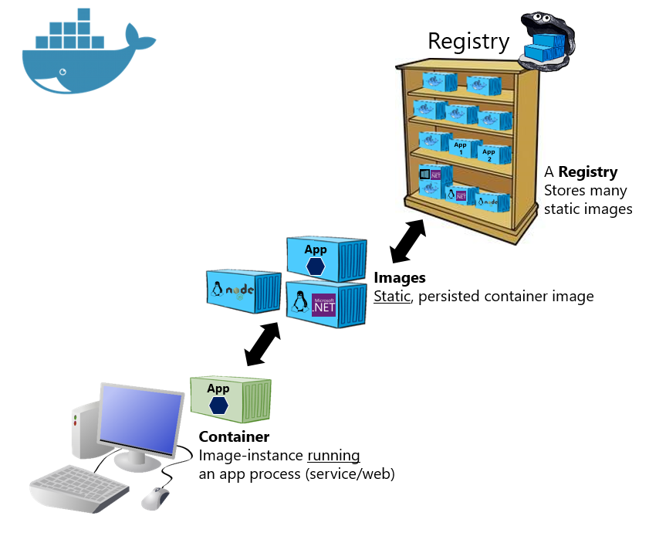
Docker and Virtualization
an image is a read-only template for tht contains a set of
instructions for creating a container that can run on a Docker platform
images are often based on other images
we can create our own image with the help of a Dockerfile
or we can use oher images from the registry
Every instruction in the Dockefile is a layer in the image
ONLY THSOSE LAYERS ARE REBUILT IN THE IMAGE
THAT HAS BEEN CHANGED
this is why Docker virtualization is lightweight
https://learn.microsoft.com/en-us/dotnet/architecture/microservices

Slide 230

Docker and Virtualization

Slide 231
Docker and Kubernetes

Slide 232
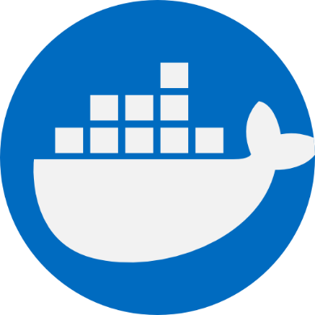
Docker and Kubernetes
Docker is an open-source technology for automating the deployment of applications as portable and self-sufficient containers that can run in the cloud

Slide 233

Docker and Kubernetes
Docker is an open-source technology for automating the deployment of applications as portable and self-sufficient containers that can run in the cloud
Kubernetes is open-source orchestration software that provides an API to control how and where those containers will run – helps in scaling

Slide 234
Docker and Kubernetes
by the way there are several orchastration tools available to manage the huge number of service instances in an efficient manner

Slide 235
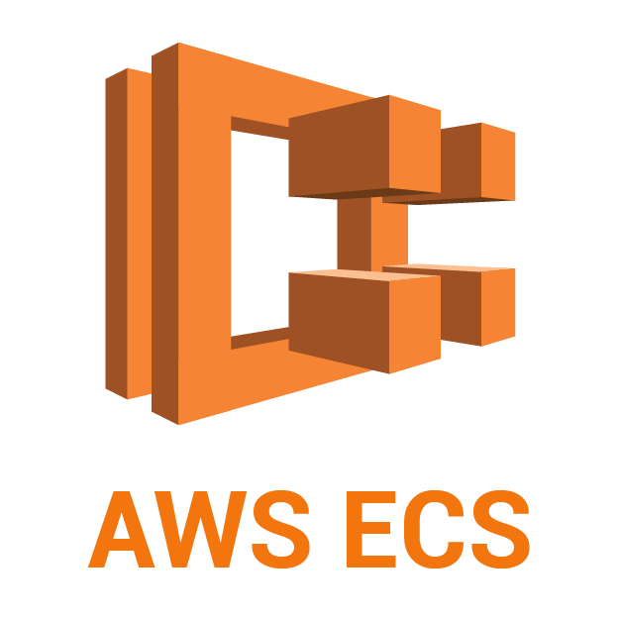
Docker and Kubernetes
by the way there are several orchastration tools available to manage the huge number of service instances in an efficient manner

Slide 236

Docker and Kubernetes
by the way there are several orchastration tools available to manage the huge number of service instances in an efficient manner

Slide 237

Docker and Kubernetes
by the way there are several orchastration tools available to manage the huge number of service instances in an efficient manner

Slide 238
Docker and Kubernetes
1.) VERTICAL SCALING
SERVICE #1
(single .jar or .war file)
vertical scaling means adding more resources to the single underlying service (such as memory or CPU)
usually it means we can handle more request
(so higher request-per-second - RPS)

Slide 239
Docker and Kubernetes
1.) HORIZONTAL SCALING
SERVICE #1
(single .jar or .war file)
SERVICE #1
(single .jar or .war file)
SERVICE #1
(single .jar or .war file)
SERVICE #1
(single .jar or .war file)
horizontal scaling means adding more units (hosts)
of the underlying service itself
its important to note that usually these instances
share information with each other !!!

